Slide 1
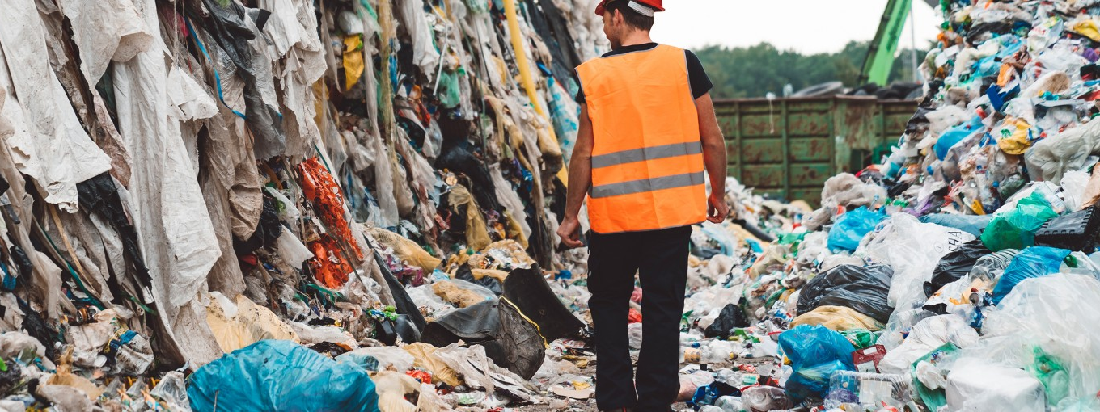
CSE3330 Spring 2020 Project 2: Online Return Induced Trash [1] by Shameen Shetty, Bigyan Adhikari, Pawan Adhikari, Andrew Chanthamany
https://www.bbcearth.com/blog/%3Farticle%3Dyour-brand-new-returns-end-up-in-landfill/
How brand new returns end up being thrown into landfills.
Photo from bbc-earth article, “Your brand new returns end up in landfill”

Slide 2
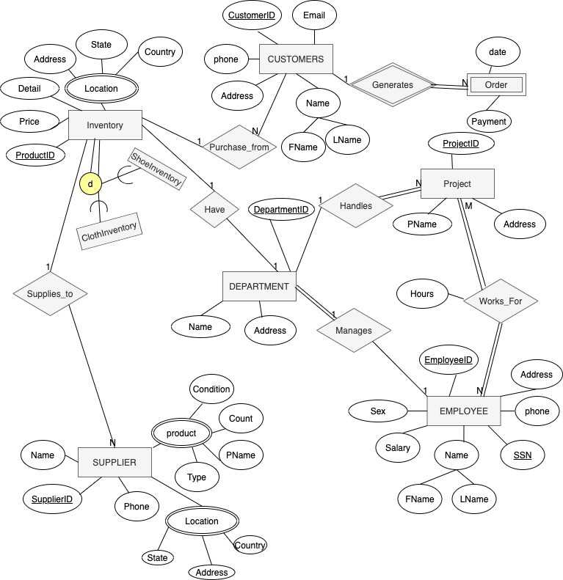
ER Schema Diagram

Slide 3
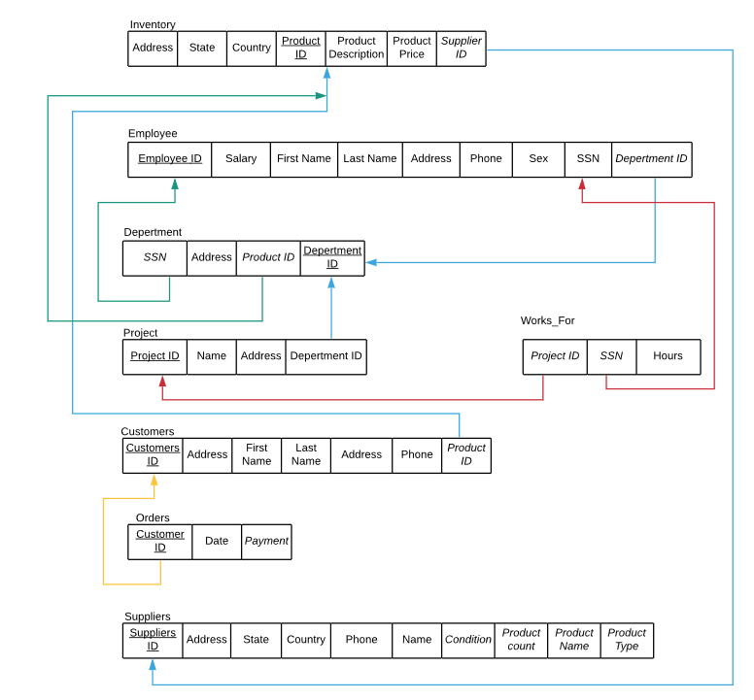
Relational Schema
Underlined : Primary
Attribute 1) Italics: foreign/ reference keys
2) 1:1 green 3) 1:N blue 4) N:M Red

Slide 4
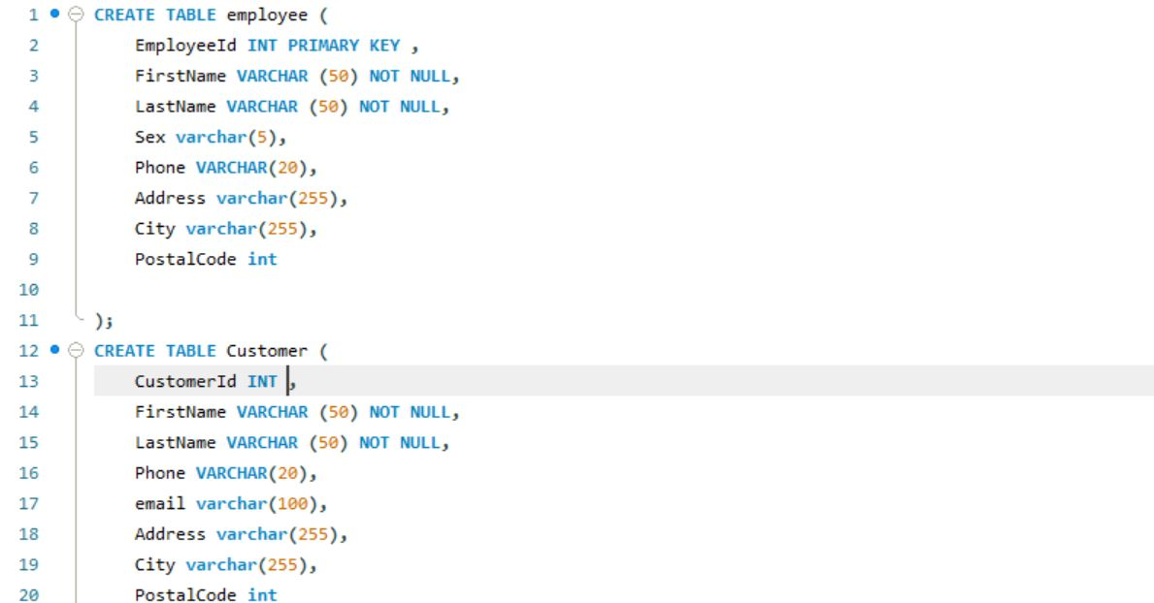

Slide 5
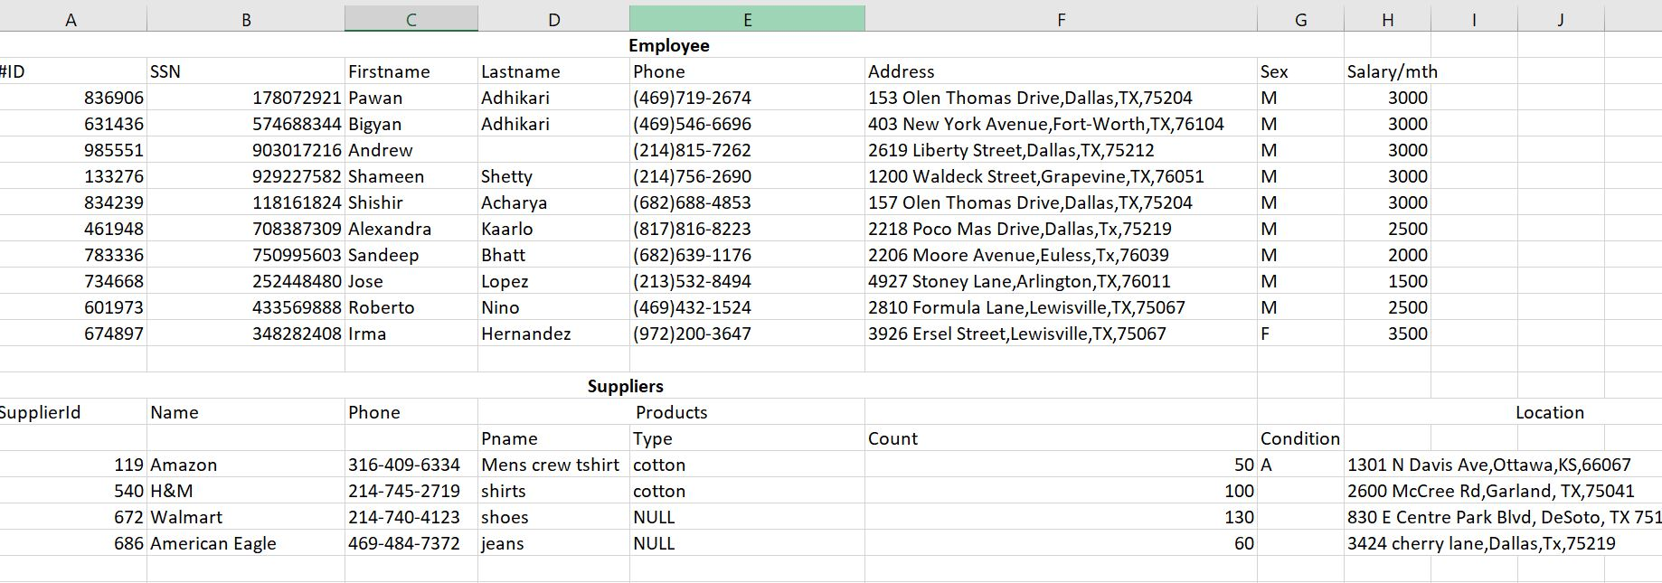

Slide 6
References
[1] https://www.youtube.com/watch?v=IgyNp7AGmkU&feature=share
[2] Elmasri and Navathe. Fundamentals of Database Systems. 7th ed., Pearson, 2016.

